Slide 1


Water Quality Classification
for Safe Drinking Prediction
A Real-Time ML-Based Water Potability Prediction System
Ananthan S | Muhammed Shahid
Predictive Analytics — Academic Year 2025–26 | Group Project 03
Predictive Analytics | Water Quality Classification | 2025–26

Slide 2




Introduction
02
2B+
24–72h
3.4M
~0%
People lack safe
drinking water
Lab testing
turnaround time
Deaths/year from
water-related diseases
Real-time
ML solutions deployed
Global Crisis
WHO (2023): 2 billion people still lack access to safely managed drinking water.
Slow Detection
Traditional lab testing takes 24–72 hours — too slow for contamination events.
ML Solution
Machine learning classifies water potability from 9 chemical properties in milliseconds.
Public Health
Accurate, interpretable predictions help engineers act on specific contaminants instantly.
Water Quality Classification | Predictive Analytics 2025–26

Slide 3

Problem Statement
03
❌ Current Challenges
✅ Our Solution
✗ Lab testing takes 24–72 hours to return results
✓ ML inference in milliseconds — real-time classification
✗ High cost — not accessible in rural / low-income regions
✓ Open-source pipeline accessible to all regions
✗ No real-time classification or automated alerts
→
✓ Streamlit web app with interactive live predictions
✗ No explainability — engineers can't pinpoint contaminants
✓ SHAP explainability highlights root-cause contaminants
✗ Class imbalance in data skews naive ML models
✓ SMOTE balancing ensures fair, unbiased model training
Water Quality Classification | Problem Statement

Slide 4







Project Objectives
04
Predict Potability
End-to-End ML Pipeline
Classify water samples as Potable or Non-Potable from 9 physicochemical parameters.
Full pipeline: preprocessing → EDA → feature engineering → SMOTE → training → evaluation.
Handle Class Imbalance
SHAP Explainability
Use SMOTE oversampling to balance 61% Non-Potable vs 39% Potable class distribution.
Make predictions interpretable — identify which features drive each potability decision.
Streamlit Deployment
IoT Sensor Simulation
Deliver a live interactive web app with sliders, WQI score, and probability output.
Simulate real-time sensor monitoring with continuous inference and confidence scores.
Water Quality Classification | Predictive Analytics 2025–26

Slide 5

Dataset Description
05
3,276
9
1,278
1,998
Total Samples
Input Features
Potable (39%)
Non-Potable (61%)
Feature Details
Class Distribution
Feature | Unit | WHO Range | Missing
pH | — | 6.5 – 8.5 | 15.0%
Hardness | mg/L | < 300 | 0%
Solids | ppm | < 500 | 0%
Chloramines | ppm | < 4.0 | 0%
Sulfate | mg/L | < 250 | 23.8% ⚠
Conductivity | μS/cm | < 400 | 0%
Organic Carbon | ppm | < 2.0 | 0%
Trihalomethanes | μg/L | < 80 | 4.9%
Turbidity | NTU | < 1.0 | 0%
Non-Potable: 61% (1,998 samples)
Potable: 39% (1,278 samples)
Source: Kaggle Water Potability
Dataset — 3,276 samples × 10 cols
Target: Potability (0 = Not Safe,
1 = Safe to drink)
Water Quality Classification | Dataset

Slide 6

Features Used
06
1
pH
2
Hardness
3
Solids (TDS)
WHO: 6.5 – 8.5
WHO: < 300 mg/L
WHO: < 500 ppm
Acid/alkalinity balance
Dissolved minerals (Ca, Mg)
Total dissolved solids
4
Chloramines
5
Sulfate
6
Conductivity
WHO: < 4.0 ppm
WHO: < 250 mg/L
WHO: < 400 μS/cm
Disinfectant residual
Chemical compound
Ionic conductivity
7
Organic Carbon
8
Trihalomethanes
9
Turbidity
WHO: < 2.0 ppm
WHO: < 80 μg/L
WHO: < 1.0 NTU
Organic matter content
Chlorination by-products
Water clarity/cloudiness
Water Quality Classification | Predictive Analytics 2025–26

Slide 7



Project Workflow — End-to-End Pipeline
07
1
2
3
4
5
6
7
8
9
Dataset
▶
Preprocessing
▶
EDA
▶
Feature Eng.
▶
SMOTE
▶
ML Training
▶
Evaluation
▶
SHAP
▶
Streamlit App
Kaggle CSV
Impute / Scale
Explore & Plot
WQI · pH_safe
Balance Classes
RF / SVM / XGB
Acc · F1 · ROC
Explainability
Live Deployment
water_potability.csv
Group-wise median
+ Winsorization
Histograms
Heatmaps
Boxplots
WQI Score
pH_safe flag
Hard/Cond ratio
Synthetic minority
over-sampling
RF 200 trees
SVM RBF
XGBoost 300
Accuracy
Precision / Recall
ROC-AUC
Beeswarm
Waterfall
Bar plot
Interactive UI
Confidence score
Each stage feeds the next — a complete data science life cycle across 10 structured phases
Water Quality Classification | Predictive Analytics 2025–26

Slide 8
Data Preprocessing
08
1. Missing Value Handling
ph: 491 missing (15.0%)
Sulfate: 781 missing (23.8%)
Trihalomethanes: 162 missing (4.9%)
Strategy: Group-wise median imputation by Potability class — preserves class signal
2. Outlier Treatment (Winsorization)
IQR-based Winsorization (1.5× fence)
Caps extreme values — no rows removed
Prevents outlier skew in model training
3. Feature Scaling — StandardScaler
Zero-mean, unit-variance normalization
Applied after train/test split (no leakage)
Ensures equal feature weight in SVM & others
Water Quality Classification | Data Preprocessing

Slide 9


Exploratory Data Analysis (EDA)
09
Feature Distributions
Correlation Heatmap
Histogram + KDE per feature split by Potability class — reveals overlap, skewness and separation power of each parameter.
12×12 Pearson correlation matrix of all engineered features. Identifies multicollinearity and inter-feature relationships.
Boxplots by Class
Class Imbalance Chart
Side-by-side boxplots for Potable vs Non-Potable — highlights median shifts and variance differences per feature.
Bar + pie visualisation of 61% Non-Potable vs 39% Potable imbalance — motivates use of SMOTE in next stage.
Water Quality Classification | Predictive Analytics 2025–26

Slide 10
Feature Engineering
10
1. Water Quality Index (WQI) — Composite Safety Score
WQI = (pH/8.5 × 0.15) + ((1 − Turbidity/6.7) × 0.20) + ((1 − Chloramines/13.1) × 0.20)
+ ((1 − THMs/124) × 0.15) + ((1 − Solids/61227) × 0.15) + ((1 − Sulfate/481) × 0.15)
2. pH Safety Flag (pH_safe)
3. Hardness / Conductivity Ratio
Binary indicator:
1 → pH ∈ [6.5, 8.5] (WHO safe range)
0 → pH outside safe range
Used directly by model as an interpretable feature.
Hard_Cond_ratio = Hardness ÷ Conductivity
Captures mineral concentration relative to ion mobility.
Provides an additional dimension not in raw features.
Water Quality Classification | Feature Engineering

Slide 11
SMOTE — Handling Class Imbalance
11
Before SMOTE
After SMOTE
Non-Potable 61% (1,998)
Non-Potable 50% (1,998)
Potable 39% (1,278)
SMOTE
Potable 50% (1,998 synthetic)
→
⚠ Skewed dataset — model biased
toward majority class (Non-Potable).
Naive accuracy misleading.
Minority class (Potable) under-predicted.
✓ Balanced training set — model
learns both classes equally.
SMOTE applied only on training data
(no leakage into test set).
Water Quality Classification | Predictive Analytics 2025–26

Slide 12


Machine Learning Models
12
Random Forest
SVM (RBF Kernel)
XGBoost ⭐
Ensemble Bagging
Kernel-based SVC
Gradient Boosting
200 estimators
max_depth = 12
5-fold stratified CV
Kernel = RBF
C = 10, gamma = 'scale'
5-fold stratified CV
300 estimators
lr = 0.05, max_depth = 6
L1 + L2 regularisation
Key Strengths:
Key Strengths:
Key Strengths:
Robust to outliers
Feature importance built-in
Handles non-linear boundaries
Low variance via bagging
Effective in high dimensions
Works well post-scaling
Good margin maximisation
Resistant to overfitting
Best across all 5 metrics
Corrects errors iteratively
Native SHAP compatibility
Handles feature interactions
Water Quality Classification | ML Models

Slide 13
Model Training Pipeline
13
01
Train/Test Split
02
SMOTE on Train Set
80% training (2,620 samples) | 20% test (656 samples)
Stratified split preserves class ratio in both sets
Oversample minority class on training data only
Final training set: 3,196 balanced samples
03
StandardScaler Fit
04
5-Fold Stratified CV
Fit scaler on training set, transform both train & test
Prevents data leakage — no test info in scaler
Cross-validation within training set
Mean CV score used for hyperparameter selection
05
Hyperparameter Tuning
06
Final Evaluation
RF: 200 trees, max_depth=12 | SVM: C=10, RBF
XGBoost: 300 trees, lr=0.05, L1+L2 regularisation
Hold-out test set (20%) — never seen during training
Metrics: Accuracy, F1, Precision, Recall, ROC-AUC
Water Quality Classification | Predictive Analytics 2025–26

Slide 14
Model Evaluation Metrics
14
Accuracy
Precision
Recall
F1-Score
ROC-AUC
Overall correct predictions / total samples
TP / (TP + FP) — avoid false 'safe' labels
TP / (TP + FN) — minimize missed unsafe water
Harmonic mean of Precision & Recall
Area under ROC curve — overall discriminative ability
Confusion Matrix Structure
ROC Curve Overview
Predicted +
Predicted −
Random Forest
Actual +
TP
True Positive
FN
False Negative
AUC: 0.86
SVM (RBF)
Actual −
FP
False Positive
TN
True Negative
AUC: 0.82
XGBoost ⭐
AUC: 0.88
Water Quality Classification | Evaluation

Slide 15
Results & Model Comparison
15
Performance on Hold-Out Test Set (20% — 656 samples)
Model | Accuracy | Precision | Recall | F1-Score | ROC-AUC
Random Forest | 0.79 | 0.76 | 0.73 | 0.74 | 0.86
SVM (RBF) | 0.74 | 0.72 | 0.68 | 0.70 | 0.82
XGBoost ⭐ | 0.81 | 0.78 | 0.76 | 0.77 | 0.88 ★
Accuracy Comparison
🏆 XGBoost — Deployed Model
Random Forest
79%
Best across all 5 metrics.
Gradient boosting corrects errors iteratively.
Native L1 + L2 regularisation prevents overfitting.
Native SHAP compatibility enables explainability.
SVM (RBF)
74%
XGBoost ⭐
81%
Water Quality Classification | Predictive Analytics 2025–26

Slide 16
SHAP Explainability
16
SHapley Additive exPlanations — Making XGBoost Transparent for Public Health Decisions
Global Bar Plot
Beeswarm Plot
Waterfall Plot
Mean absolute SHAP values per feature.
Ranks overall feature importance across all predictions.
WQI and Sulfate consistently top-ranked.
Per-sample SHAP values — shows direction (positive/negative) and magnitude.
Reveals how each feature value shifts predictions toward Safe or Unsafe.
Single-prediction explanation step-by-step.
Shows exactly which features pushed a specific water sample
toward Potable or Non-Potable classification.
Key SHAP Findings:
Sulfate & Solids are the most influential raw features • Engineered WQI consistently ranks top-3 • High Chloramines strongly pushes toward Not Potable • pH_safe flag provides a clean interpretable signal
Water Quality Classification | SHAP Explainability

Slide 17

Streamlit Web Application
17
Sidebar Sliders
WQI Computation
One-Click Predict
9 parameter sliders (pH, Turbidity…) — one per raw feature. Intuitive range-bounded inputs.
Automatic Water Quality Index calculated in real-time from slider values — displayed prominently.
XGBoost inference on engineered features. Result: Potable ✅ or Not Potable ❌.
Probability Chart
Input Summary Table
Error Handling
Bar chart of class probabilities — shows confidence of each prediction visually.
Full summary of all 9 raw + 3 engineered features displayed for transparency.
Graceful handling of edge-case slider values — app never crashes on boundary inputs.
Water Quality Classification | Predictive Analytics 2025–26

Slide 18
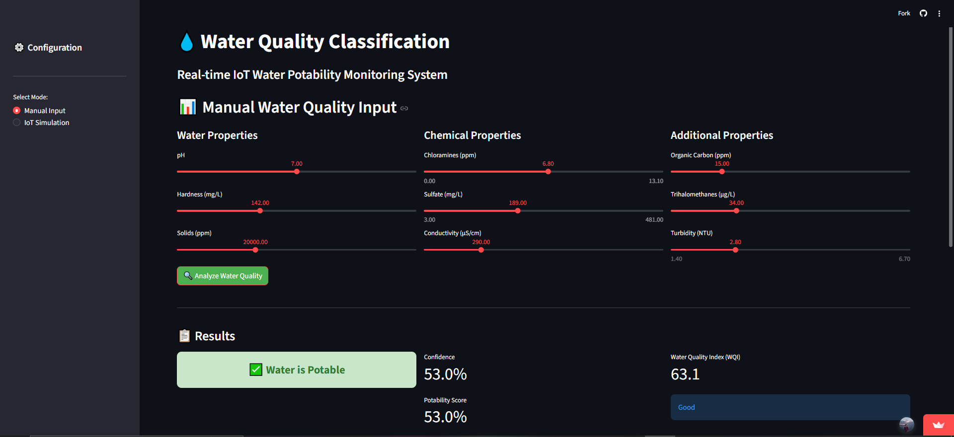
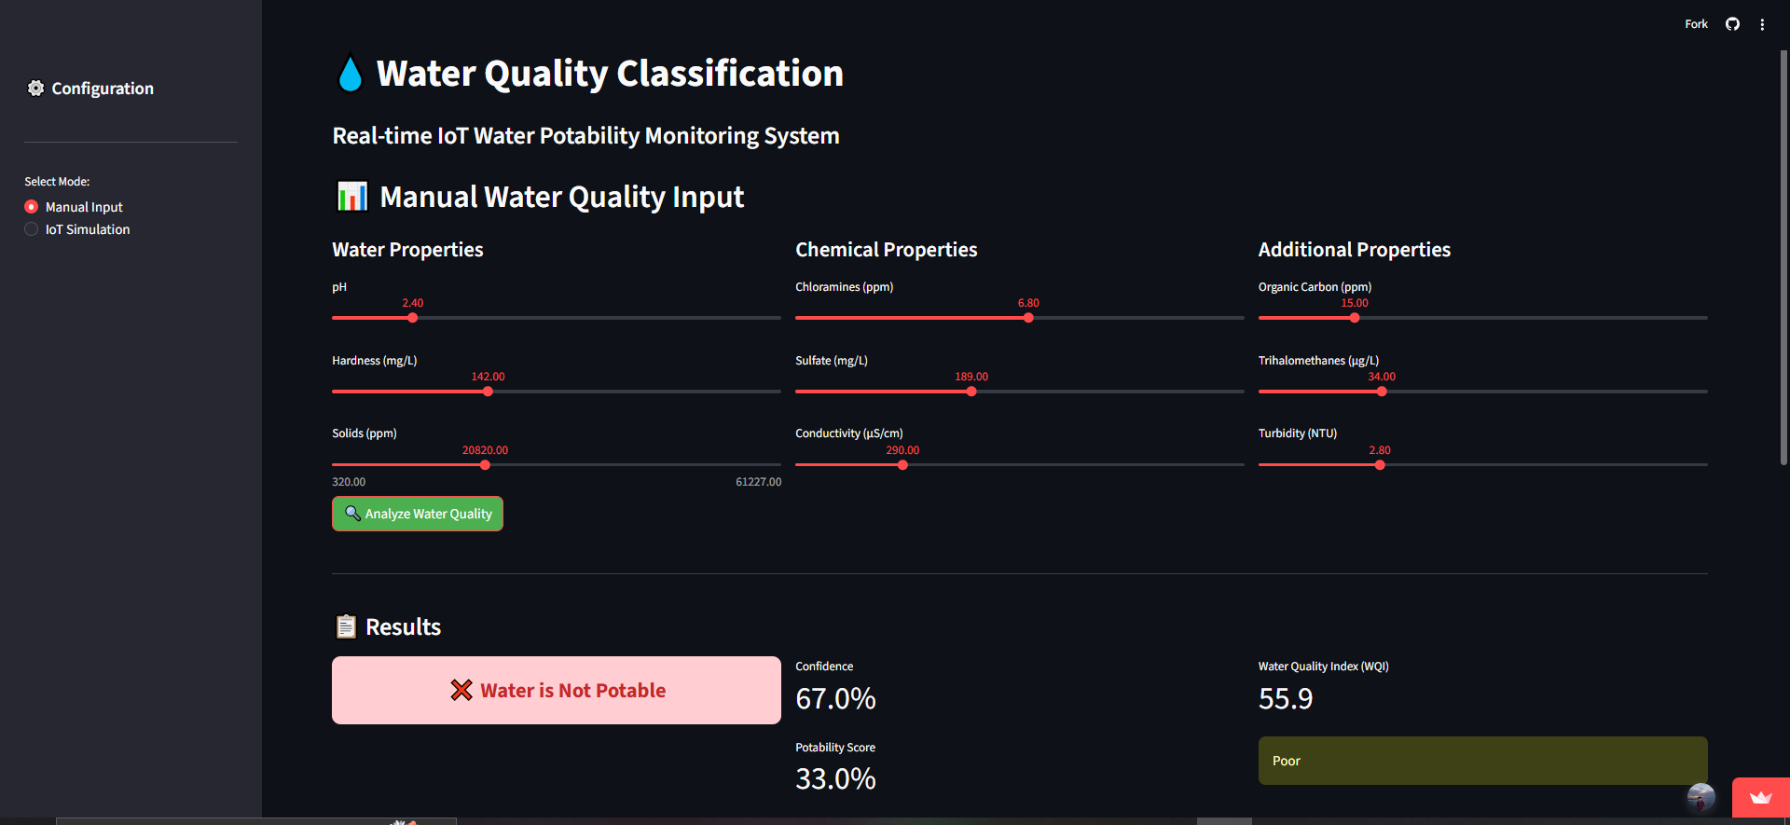
Streamlit Web Application
🌐 Live Demo
Streamlit App: https://predictive-project03-ug6mfxcp9ag8rssuuqvt27.streamlit.app/
Water Quality Classification | Predictive Analytics 2025–26

Slide 19
IoT Sensor Simulation
18
Simulated Real-Time Monitoring Architecture
→
→
→
IoT Sensor
(Simulated)
Feature
Generation
XGBoost
Inference
Monitoring
Dashboard
Sample Simulation Output
# | Time | pH | Turbidity | WQI | Result | Confidence
1 | 01:33:12 | 7.3 | 3.21 | 0.612 | ✅ Potable | 84.3%
2 | 01:33:12 | 5.1 | 5.87 | 0.341 | ❌ Not Potable | 91.2%
3 | 01:33:13 | 7.9 | 2.44 | 0.708 | ✅ Potable | 88.6%
Water Quality Classification | IoT Simulation

Slide 20


Technologies Used
19
Language
ML Models
Imbalance
Python 3.10
scikit-learn · XGBoost
imbalanced-learn · SMOTE
Explainability
Data Processing
Visualisation
SHAP
pandas · NumPy
Matplotlib · Seaborn
Web App
Version Control
Notebook
Streamlit
Git · GitHub
Jupyter Notebook
Water Quality Classification | Predictive Analytics 2025–26

Slide 21

Future Scope
20
Live IoT Integration
Mobile Application
01
02
Connect to physical sensors (Arduino / Raspberry Pi) via MQTT for continuous water quality monitoring in the field.
React Native mobile app wrapping the Streamlit API — field workers can classify samples from their phones.
Regional Dashboard
Deep Learning — TabNet
03
04
SHAP-powered region-specific water quality maps highlighting contamination hotspots across geographies.
Explore TabNet for tabular classification — attention mechanism may capture complex feature interactions better.
Multi-Class Severity
Concept Drift Detection
05
06
Extend from binary (Safe/Unsafe) to severity levels: Safe / Borderline / Contaminated / Critical.
Monitor model performance on incoming data streams — retrain automatically when drift is detected.
Water Quality Classification | Future Scope

Slide 22

Conclusion
21
Successful ML Pipeline
XGBoost Best Model (81% Acc)
End-to-end data science pipeline across 10 structured stages — from raw CSV to live Streamlit deployment.
XGBoost outperforms RF and SVM across all 5 metrics. ROC-AUC of 0.88 confirms strong discriminative ability.
Interpretable Predictions
Fair & Balanced Training
SHAP analysis makes the model transparent — critical for public health decisions. WQI and Sulfate are top drivers.
SMOTE ensures both classes are equally learned — reducing bias toward the Non-Potable majority class.
Real-Time Deployment Ready
Public Health Impact
Streamlit app with live inference, WQI computation, and probability output — deployable in minutes via Streamlit Cloud.
Millisecond inference vs 24–72h lab testing. Scalable, accessible, and explainable water safety for all regions.
Water Quality Classification | Predictive Analytics 2025–26

Slide 23
Thank You!
Questions & Answers
Ananthan S (@ananthans-Techie) | Muhammed Shahid (@muhammedshahidsds25-collab)
github.com/ananthans-Techie/Predictive-Project03
Predictive Analytics — Group Project 03 — Academic Year 2025–26
Water Quality Classification for Safe Drinking Prediction | Built with passion, not just to finish it.

